Slide 1


Team Agile Robotic Control
Advisor: Dr. Rodriguez
Logan Beaver - ME
Justin Campbell - ME
Tyler Paddock – CE/EE
Ronald Shipman – ME

Slide 2
Project Overview
Develop initial robotics platform
Public Outreach
Increase interest in STEM fields
Engineering deficit
Fluid Power
Educational robotics platform
Fluid Power
Control Systems
Robotics

Slide 3
Major Design Decisions
Quadruped Locomotion
Agile motion
Stable
Rugged Terrain
Two Links per Leg
Pneumatic Power
High energy density
Clean and lightweight

Slide 4
Major Constraints and Objectives
Does not weight over 35 Kg
Operational speed up to 0.5 m/s
Gait implementations for creep and walk
Emergency stops easily accessible
Battery life of at least 3 hours for pneumatic components
Onboard batteries and control system
Tethered air supply

Slide 5
Power Source Options
 | Advantages | Disadvantages
Hydraulic Power Source | -Highest achievable power density | -High maintenance -Heavy -Dirty
Electric Power Source | -Accurate positioning | -Lowest achievable power density -Noncompliant
Pneumatic Power Source | -Higher power density than electric power -Low Maintenance -Compliant action from fluid compression | -Compressible fluid causes inaccuracy in positioning

Slide 6
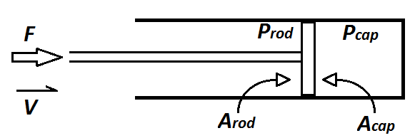
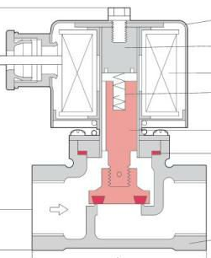
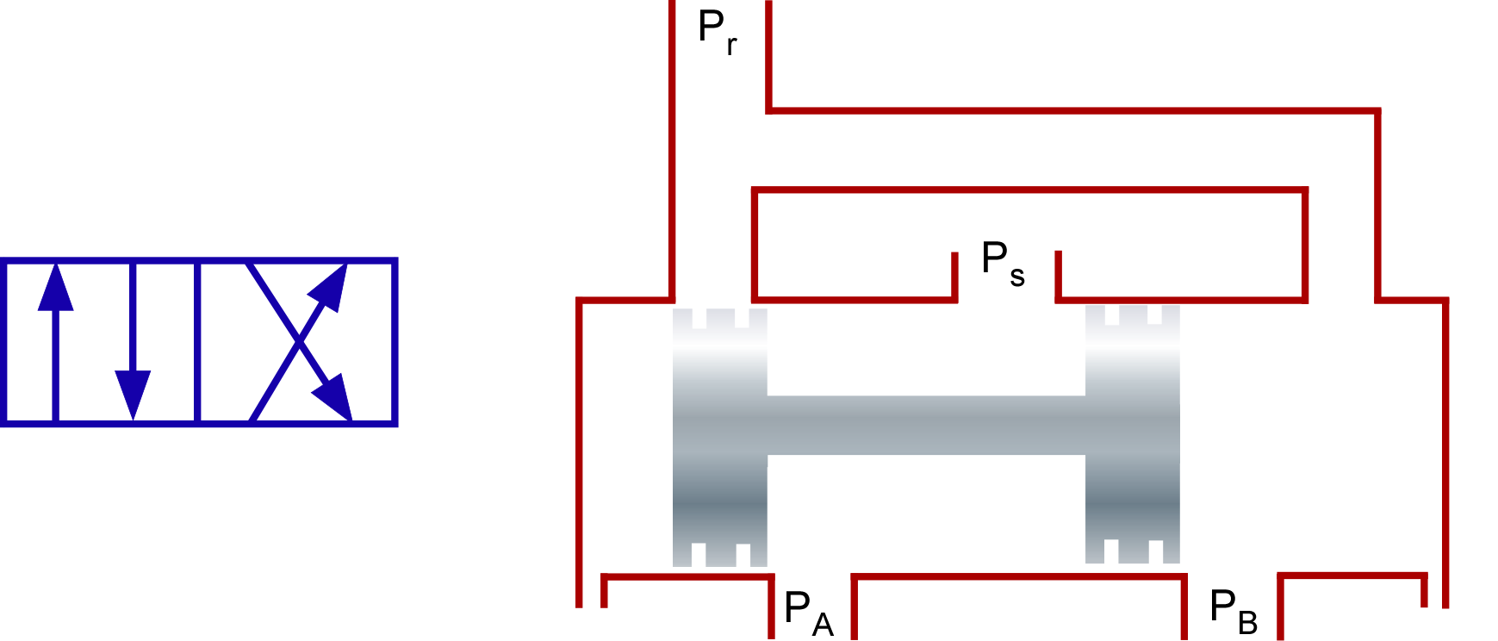

Components
Pneumatic components include:
Receiver Tank
Air Compressor
Double Acting Air Cylinders (w/ feedback)
Solenoid Valve
Directional Control Valves (4/2)
Pressure Relief Valve
Tubing
$$F =P_{cap}A_{cap} −P_{rod}A_{rod}$$

Slide 7
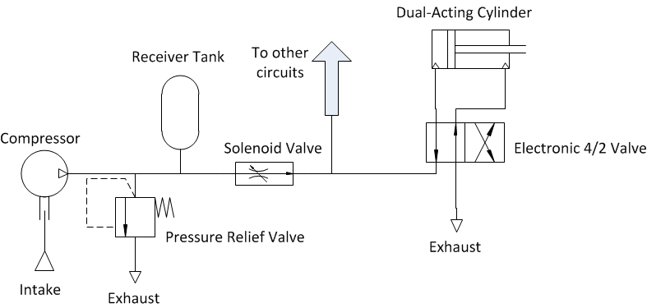
Pneumatic Circuit for single cylinder

Slide 8
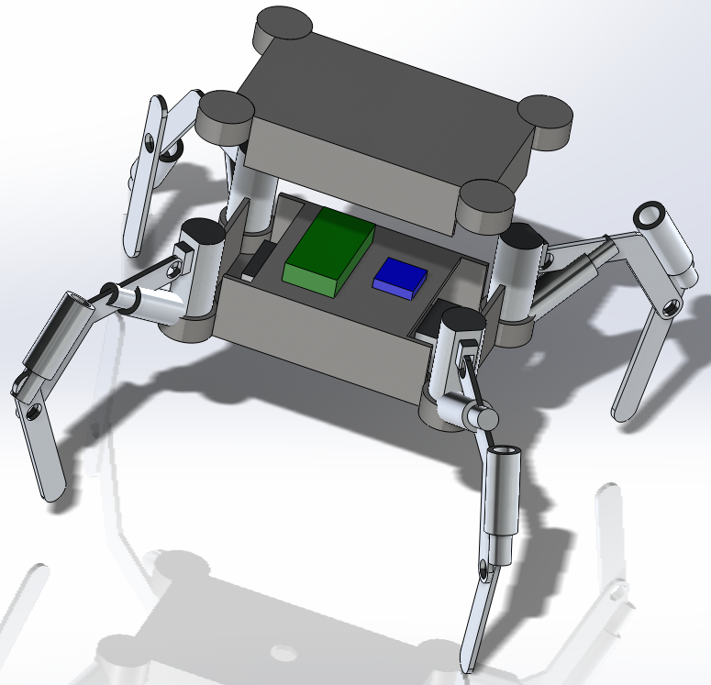
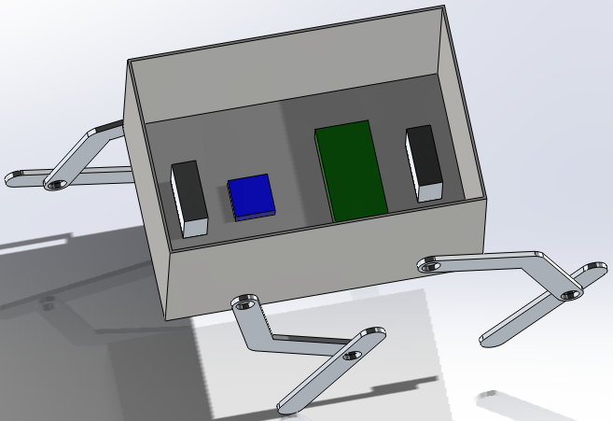
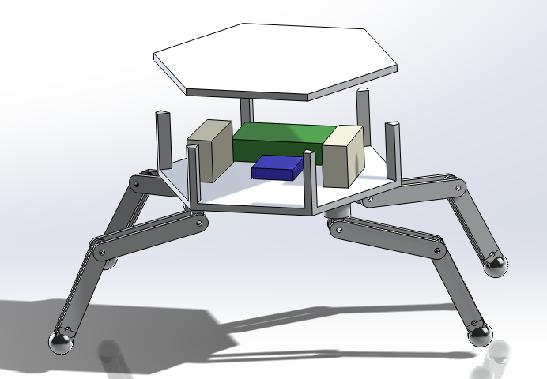
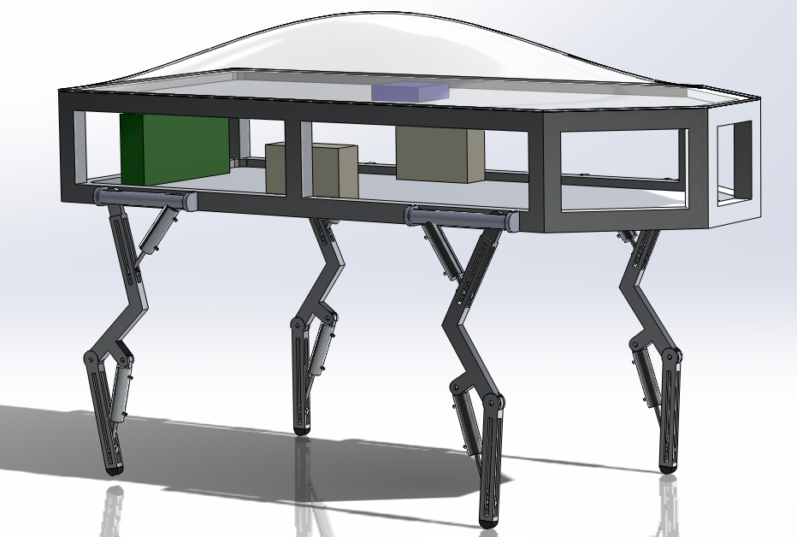
Design Ideas
Hexabot
DogeBot
Arachnea
Boxxy

Slide 9
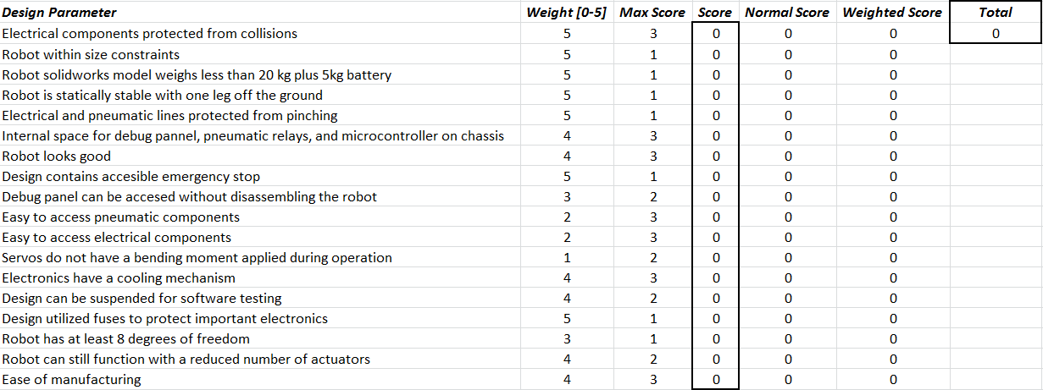
Mechanical Design Matrix

Slide 10
Dogebot
Pros
Legs cannot interfere with each other
Adequate space for components
Open sides for easy accessibility
Cons
Legs may be susceptible to bending
Near the limit on all dimensions and weight

Slide 11
Design Updates
Chassis
Extruded T-Slotted Aluminum Frame
Easy to assemble and attach components
Decreased dimensions to reduce weight
Legs
Fixed piston attachment points
Attached to top of chassis to increase stability

Slide 12
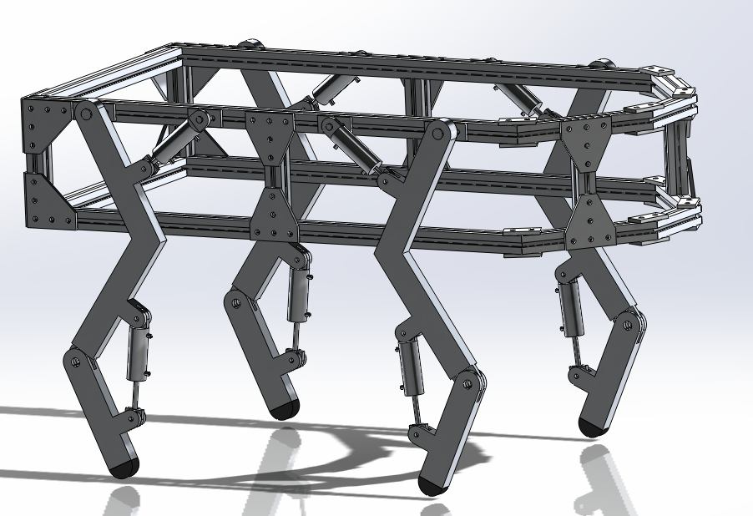
DogeBot 2.0

Slide 13

Kinematic Model
Homogenous Transformations
Determines cylinder stroke
Shank X Acceleration:
$$\text{LH}\text{4∗}\text{cos}\text{(}\text{tb}\text{)∗}\text{tbdot}\text{^2 − }\text{LK}\text{4∗}\text{cos}\text{(}\text{th}\text{4)∗}\text{th}\text{4}\text{dot}\text{^2 + }\text{xddot}\text{ + }\text{LH}\text{4∗}\text{tbddot}\text{∗}\text{sin}\text{(}\text{tb}\text{) − }\text{LK}\text{4∗}\text{th}\text{4}\text{ddot}\text{∗}\text{sin}\text{(}\text{th}\text{4) − }\text{S}\text{4∗}\text{tk}\text{4}\text{ddot}\text{∗}\text{sin}\text{(}\text{tk}\text{4)}$$

Slide 14

Dynamic Model
$q=\left[\begin{aligned}\text{X} \\ \text{Y} \\ {\text{θ}}_{Body} \\ {\text{θ}}_{Hip 1} \\ {\text{θ}}_{Knee 1} \\ {\text{θ}}_{Hip 2} \\ {\text{θ}}_{Knee 2} \\ {\text{θ}}_{Hip 3} \\ {\text{θ}}_{Knee 3} \\ \begin{aligned}{\text{θ}}_{Hip 4} \\ {\text{θ}}_{Knee 4}\end{aligned}\end{aligned}\right]$
Non-inertial reference frame
Lagrangian Mechanics
Arbitrary global reference frame
Determines mechanical properties of components
27 Equations with state vector q

Slide 15
Control architecture
Control algorithms: Software implemented PIDs
Software: MATLAB/Simulink model of the control is developed and
Hardware: Arduino Mega 2560
Control Feedback: Position feedback from the pneumatic cylinders

Slide 16
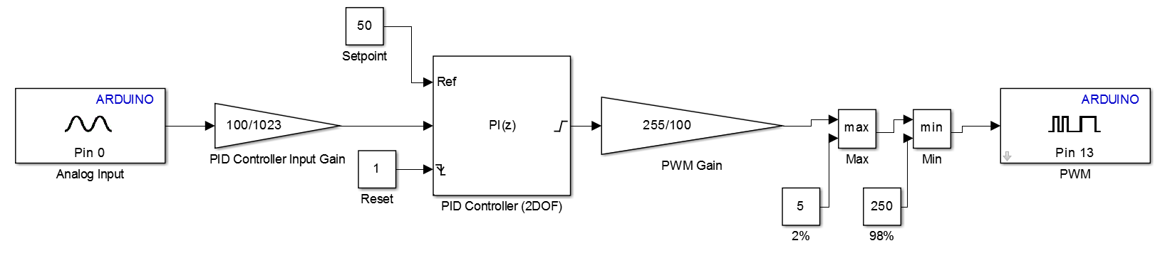
PID Model

Slide 17
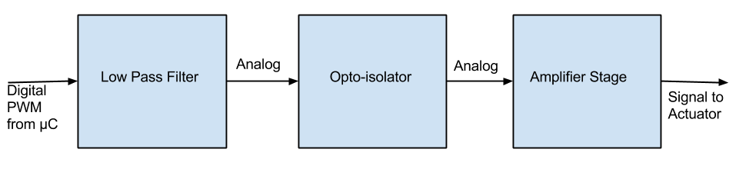
Signal Conditioning
PWM signals from the microcontroller are filtered into analog signals to drive the pneumatic actuators
The analog signals will be scaled by amplifiers to the correct voltage required by the pneumatic actuator
Opto-isolators used to protect microcontroller by separating power circuits

Slide 18
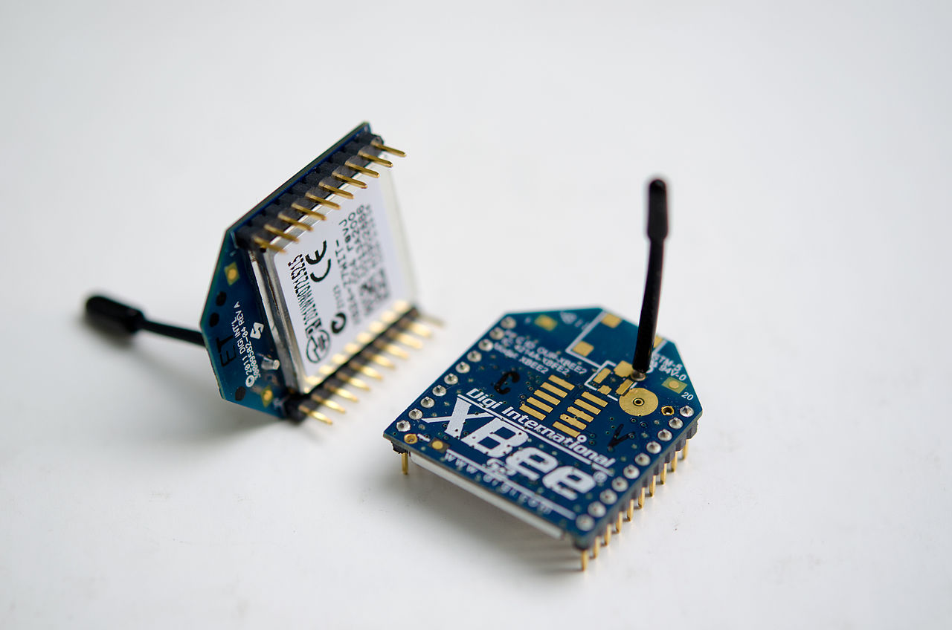
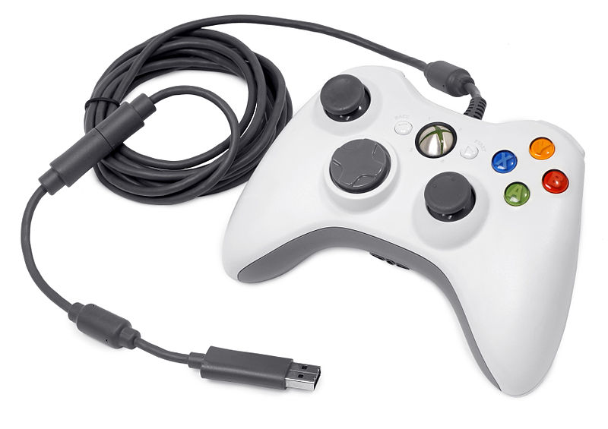
User Interface and Remote COntrol
Xbee short range radio devices using IEEE standard 802.15.4
Range: 100 meters
250Kbps maximum
2.4GHz operating frequency

Slide 19
What’s Next?
Decide on final pneumatic cylinder based on simulations
Operational Motherboard Assembled
Gather air cylinder response data
Experiment with single pneumatic leg control
Build and assemble robot subsystems
Observe final system behavior
Test gait implementations

Slide 20
Questions?

